Slide 1
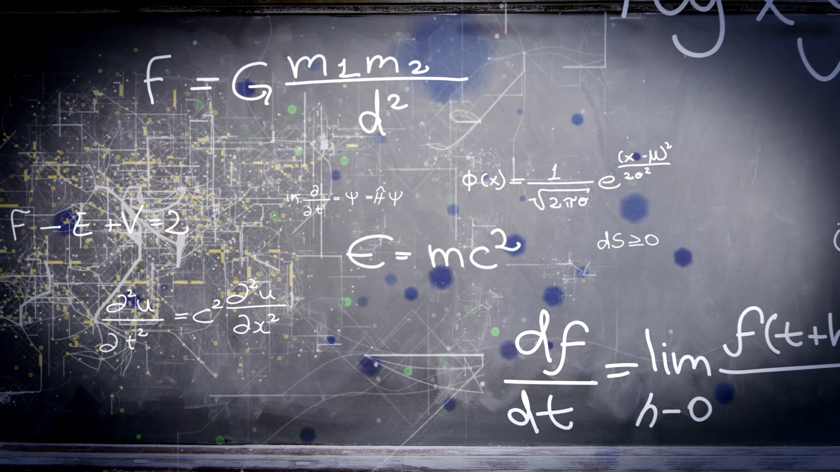
Physics Informed Neural Networks (PINNs)
By: Gabriel Kret and Adin Sacho-Tanzer

Slide 2
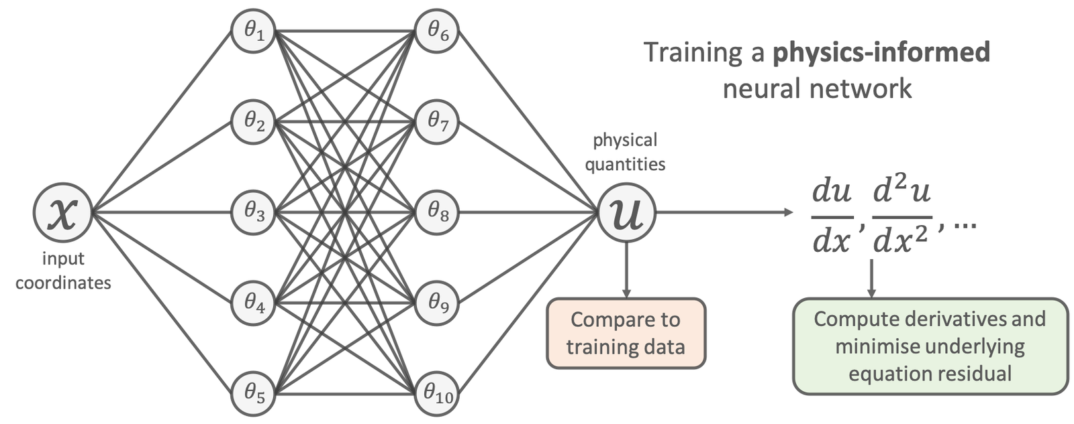
What are PINNs?
PINNs = Neural Networks + Physical Laws
Instead of training only on data, PINNs respect physical laws (like Newton’s laws, Navier-Stokes, Heat Equation).
Why is this Cool?
They solve complex equations like Partial Differential Equations (PDEs).
Less data? No problem! PINNs use prior knowledge of physics.

Slide 3
Why Do We Need PINNs?
Classical Methods (Finite Difference, Finite Element):
Accurate, but expensive and slow for complex problems.
Struggle in high dimensions.
Machine Learning (ML):
Fast but ignores physics (might break the laws of motion!).
PINNs to the Rescue!
Combines a standard Neural Networks speed with (potentially) more accuracy by enforcing physical laws and theory.

Slide 4
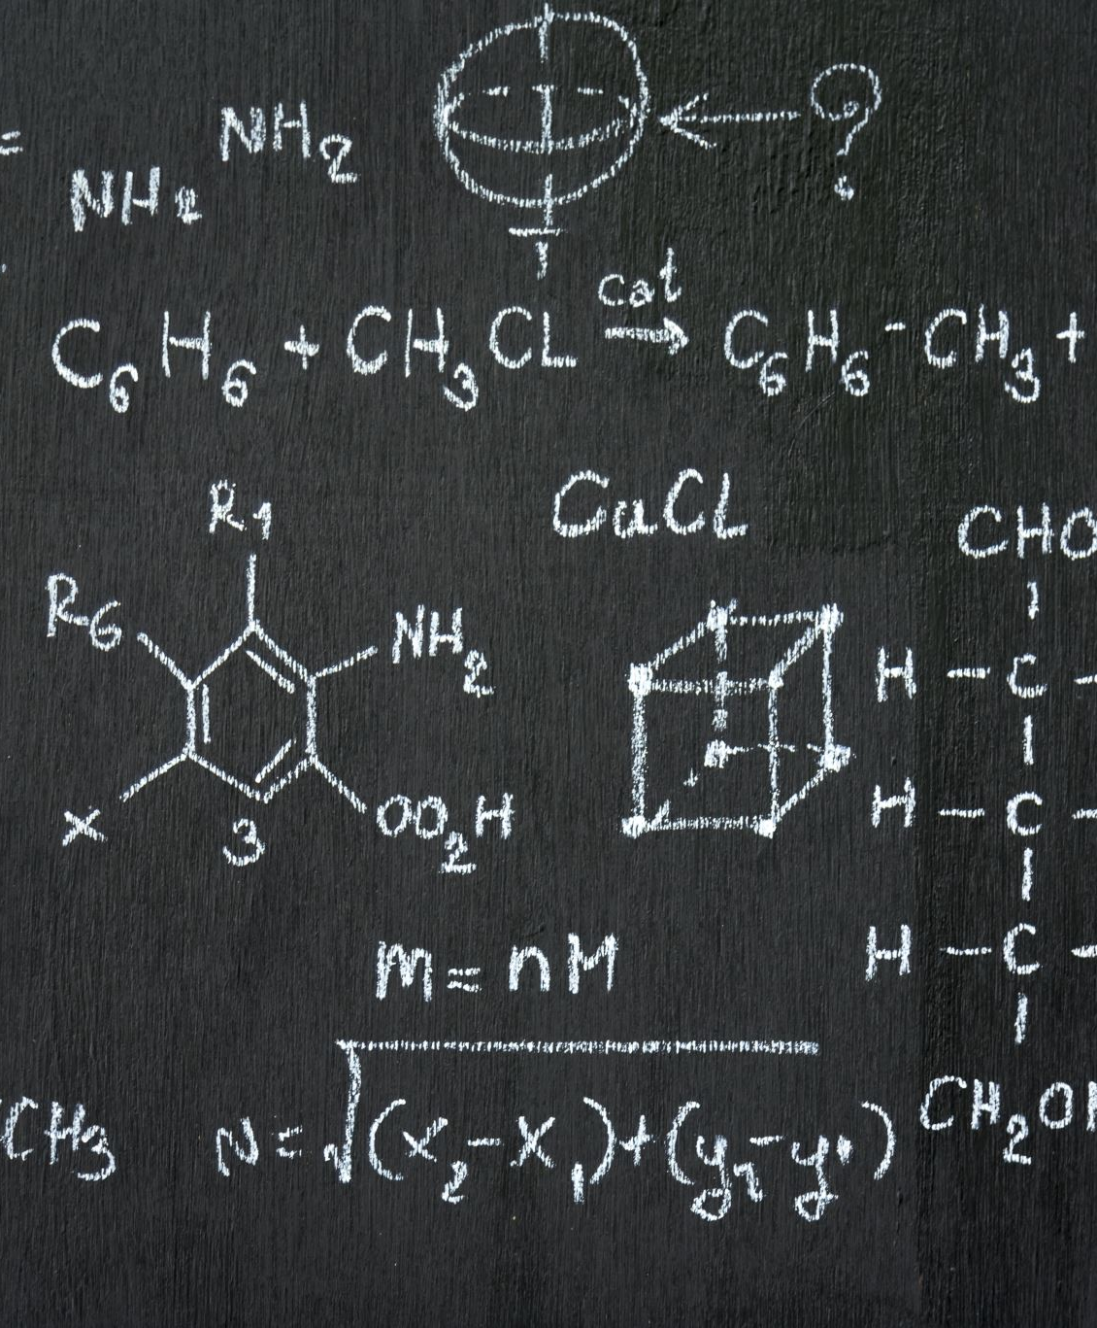
How Do PINNs Work?
Inputs: Space (x, y, z), Time (t) and any other physical quantity needed for the PDE solution.
Outputs: Approximate the solution to PDEs (e.g., temperature, velocity).
Loss Function:
Data Loss (matches known data).
Physics/PDE Loss: Residual error in the governing PDEs (enforces physical laws).
Boundary Condition Loss: Error in boundary conditions
Training: Adjust weights in the neural network to minimize the combined loss.

Slide 5
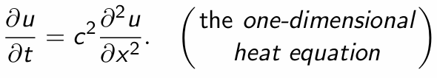
Example - Heat Equation 🔥
What is it?: Describes how heat spreads over time.
(Where u is temperature, c is thermal diffusivity).
Classical Approach: Numerical solution for Heat Equation
PINNs: Use a neural network to approximate u and satisfy the equation everywhere.

Slide 6
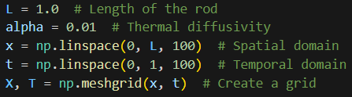
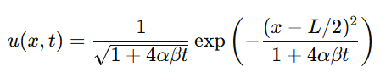
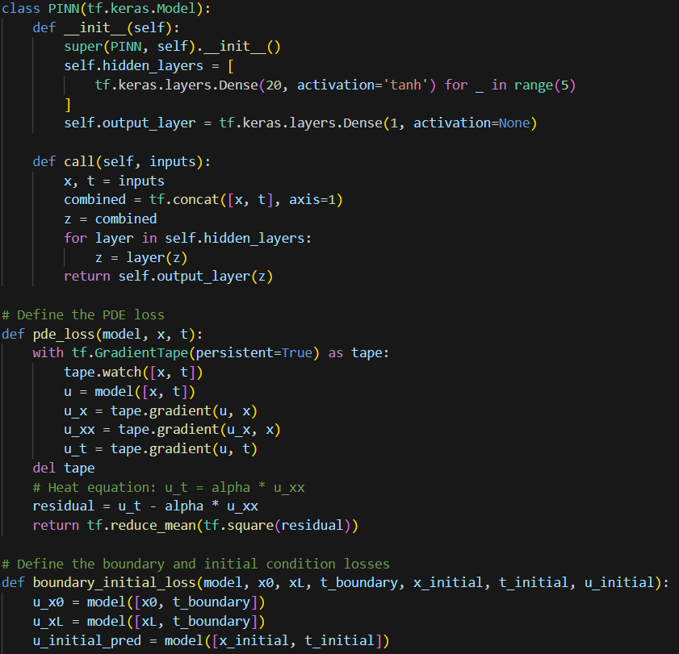
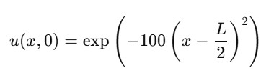
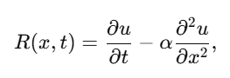
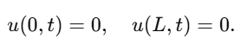
PINNs vs. Standard Analysis
Analytical Solution
Pinn’s IC, BC, & PDE Error

Slide 7
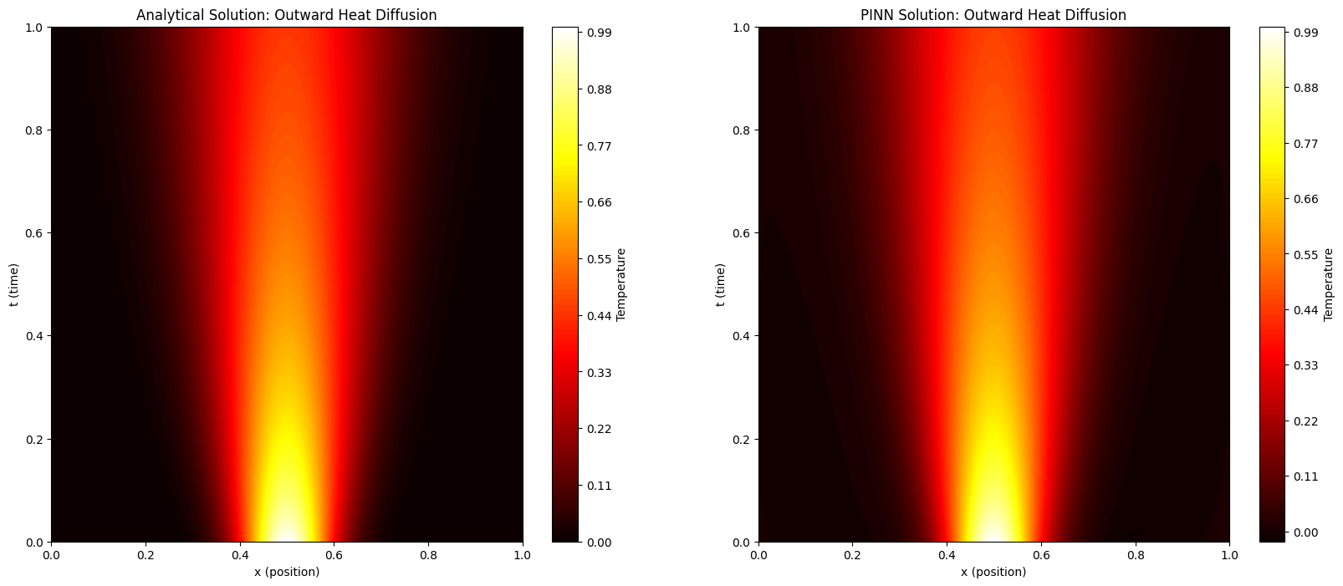
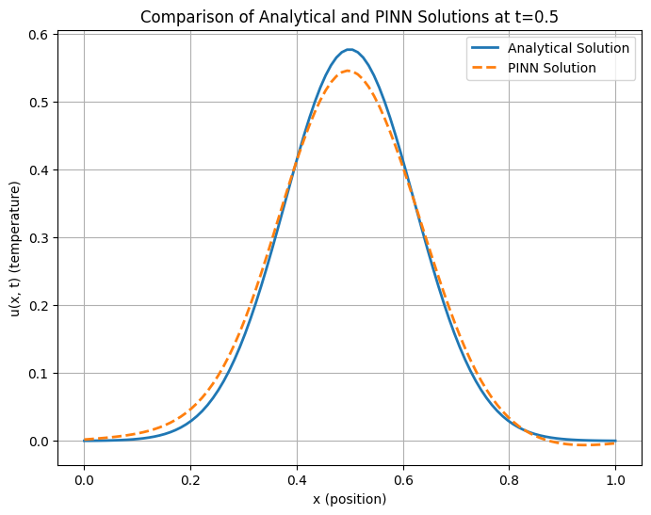

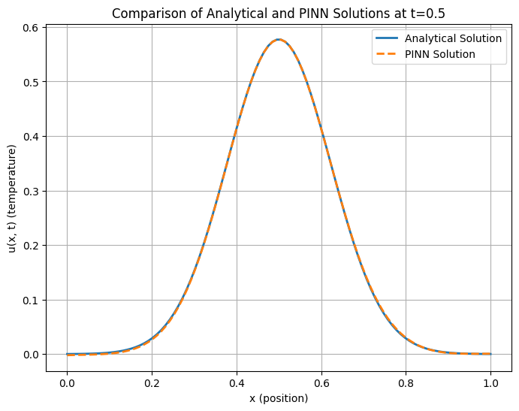
After 200 Epochs:
After 2000 Epochs:

Slide 8
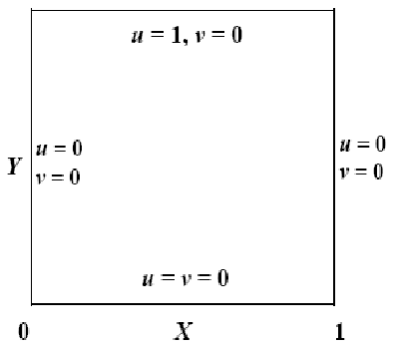
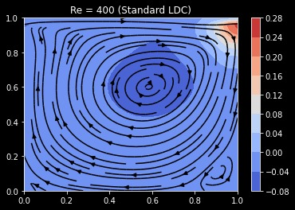
Example 2- Fluid Flow in Lid-Driven Cavity
Lid-driven cavity- 2D fluid flow problem
Fluid is stationary relative to walls on sides and bottom
Fluid has some x-velocity on top (driven by lid)
Image source: https://www.researchgate.net/figure/Boundary-Conditions-for-the-Lid-driven-Cavity_fig2_260840120

Slide 9
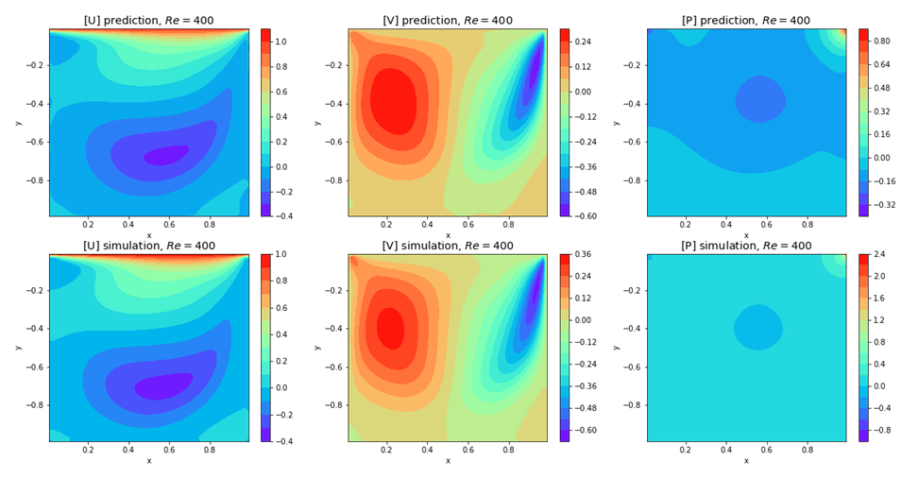
Solution comparison
Source: Jay P. Narain , Lid Driven Cavity Flow: Review and Future Trends, American Journal of Fluid Dynamics, Vol. 12 No. 1, 2022, pp. 1-15. doi: 10.5923/j.ajfd.20221201.01.

Slide 10
PINNs vs Traditional Methods
Feature | Traditional Methods | PINNs
Data Requirement | More | Less
Scalability to Higher Dimentions | Difficult | Easier
Speed | Slow for large systems | Training can be lengthy. faster after training
Flexibility | Mesh-dependent | Mesh-free

Slide 11
Applications of PINNs 🌍
Fluid Dynamics: Predict flow of air/water using Navier-Stokes equations.
Heat Transfer: Analyze temperature distribution.
Structural Analysis: Stress and strain in materials.
Quantum Mechanics: Solve Schrödinger’s equation.
Inverse Problems: Discover hidden parameters from limited data.

Slide 12
Challenges of PINNs 🤔
Training is Slow: Physics loss makes it tricky to optimize.
Accuracy Issues: Struggles near boundaries or sharp changes.
High Computational Cost for very large networks.
Tuning Parameters: Choosing the right network architecture.

Slide 13
Future of PINNs 🚀
Hybrid PINNs: Combine PINNs with traditional solvers for better accuracy.
Enhanced Training: Use advanced optimizers for faster convergence.
Applications: Weather prediction, real-time simulations, and more!

Slide 14
Thank You!
PINNs combine physics and neural networks to solve complex problems.
Faster, scalable, and adaptable to many real-world scenarios.

